Slide 1
OPEN PROJECT#1 : HW+SW Baby Motion Sensor with BTLE
Thomas Tsai
thomas@biotrump.com
https://www.facebook.com/groups/taiwan.open.platform.club/

Slide 2
DISCLAIMER
All Trademarks mentioned herein belong to their respective owners.
The OWNER is located at http://www.biotrump.com and http://www.open-platform-club.org/.
All the information contained in the pages is provided “as is”.
The OWNER disclaims all warranties with regard to this information, including all implied warranties of merchantability and fitness for a particular purpose.
In no event shall The OWNER be liable for any special, indirect or consequential damages or any damages whatsoever resulting from loss of use, data or profits, whether in an action of contract, negligence or other tortious action, arising out of or in connection with the use or performance of this information.
The information contained in the pages could contain technical inaccuracies or typographical errors.
The OWNER reserve the right to make changes to any information contained within the pages and to make improvements and or changes in the products and programs described in the pages at any time and without notice.

Slide 3
Topics
Bluetooth Low Energy, Bluetooth Core V4.0
Nordic 51822
MPU6050 or MPU9150
Buzzer/beeper
LED
Motor / Vibrator
Phone App
Web management

Slide 4
Bluetooth Low Energy

Slide 5
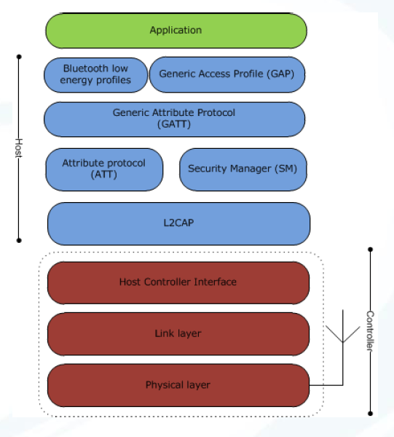
Architecture
L2CAP
Segmentation and reassembly of packets
ATT
Ability to read/write attribute values
GATT
Grouping of attributes

Slide 6
Link Layer Specification

Slide 7
ATT

Slide 8
GATT

Slide 9
Nordic nrf51822

Slide 10
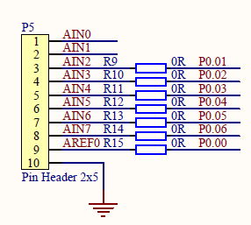
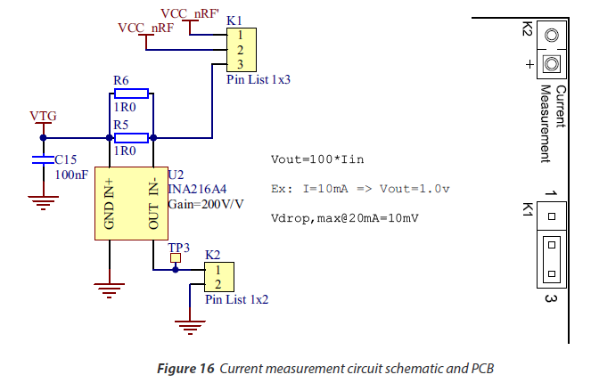
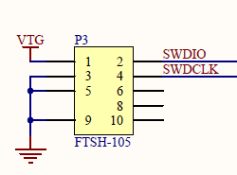
Power PCA1000x without nrfGo MB
The board can be powered by connecting VCC to pin 2 on K1, and connect the ground to the GND "pin" at P5/P3.

Slide 11
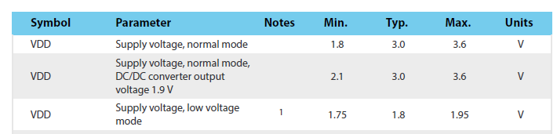

Slide 12
S110 softdevice
BluetoothR low energy (BLE) Peripheral protocol stack solution.
pre-compiled and linked binary software implementing a Bluetooth 4.0 low energy (BLE) protocol stack.
The S110 is compatible with selected nRF51 System on Chip (SoC) devices.
The API is a standard C language set of functions and data types that give the application complete compiler and linker independence from the SoftDevice implementation.
A SoftDevice enables the application programmer to develop their
code as a standard ARM Cortex™-M0 project without needing to integrate with proprietary chip-vendor software frameworks.
Any ARM Cortex™-M0 compatible toolchain can be used to develop Bluetooth low energy applications with the S110 SoftDevice.

Slide 13
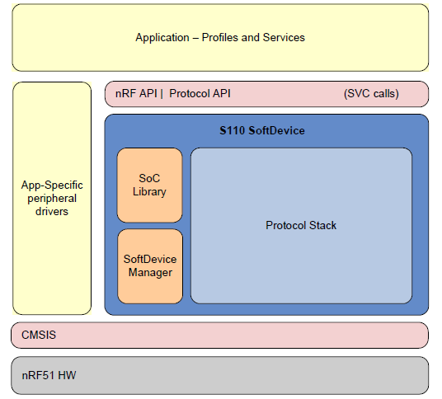

Slide 14
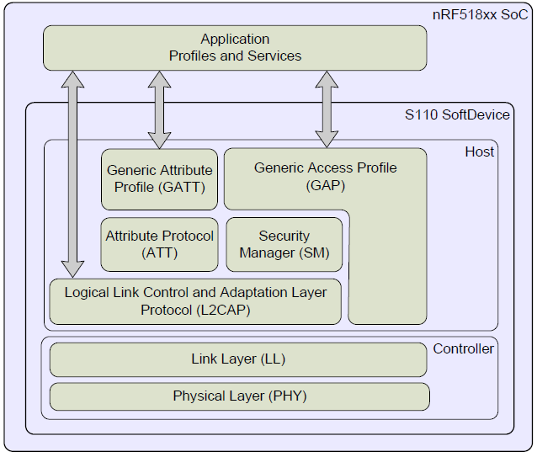
LE stack architecture

Slide 15
Bluetooth low energy features
GAP, GATT, SM, and L2CAP are implemented in the SoftDevice and managed through the API.
GAP and GATT procedures and modes that are common to most profiles, such as the handling of discoverability, connectability, pairing, and bonding,
are implemented in the stack.
The BLE API is consistent across Bluetooth role implementations where features in common have the same
interface. In the following sections, the features of the BLE stack in the S110 SoftDevice are identified.

Slide 16
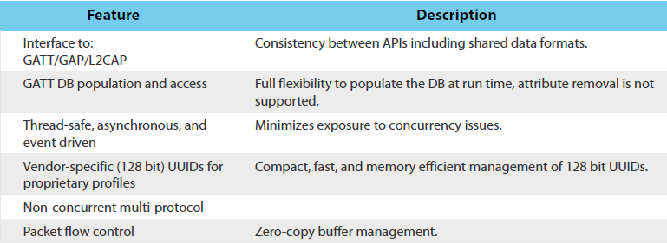
API

Slide 17
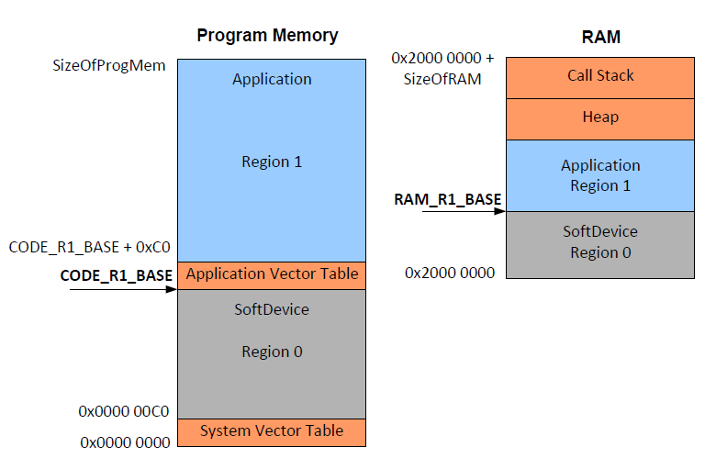

Slide 18
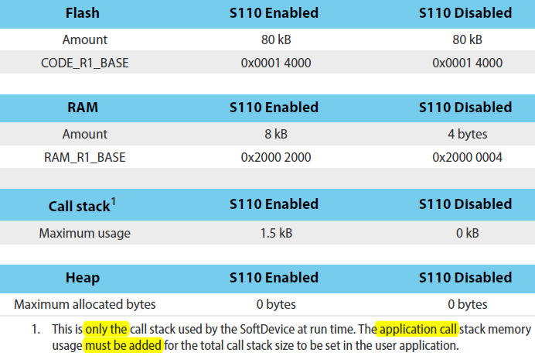

Slide 19
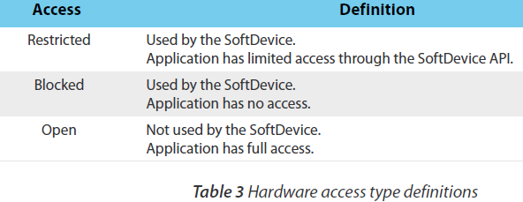
Hardware blocks and interrupt vectors

Slide 20
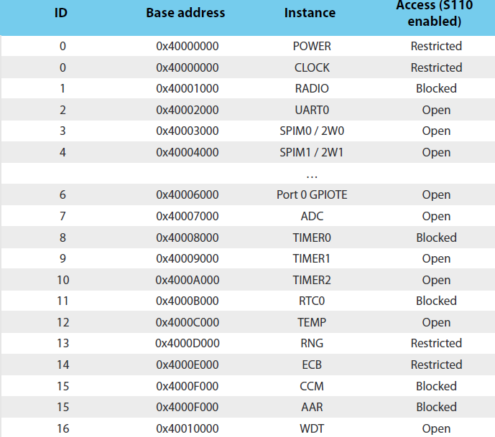

Slide 21
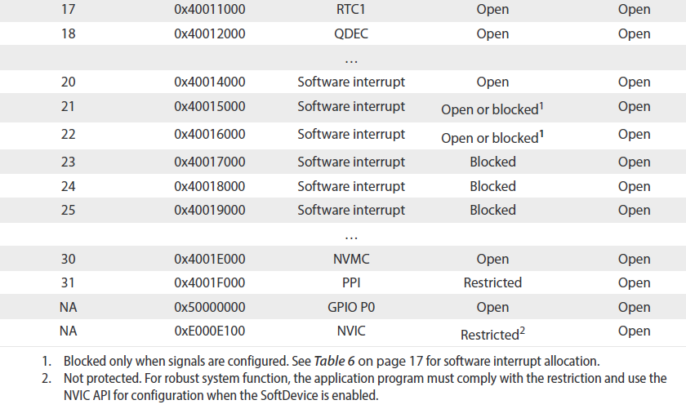

Slide 22
MPU6050/9150
https://github.com/jrowberg/i2cdevlib/tree/master/Arduino
Nordic SDK
c:\Nordic Semiconductor\nRF51 SDK_v4.2.0.25053\Nordic\nrf51822\Source\ext_sensors\mpu6050\

Slide 23
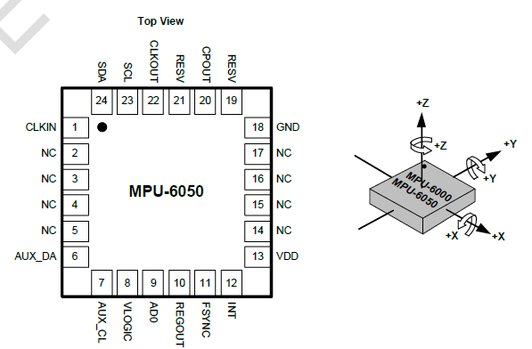

Slide 24
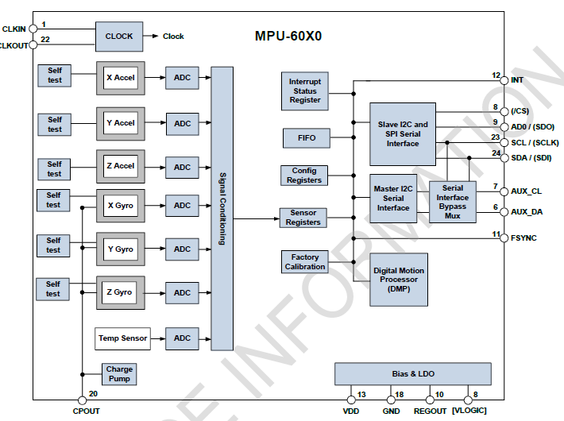

Slide 25
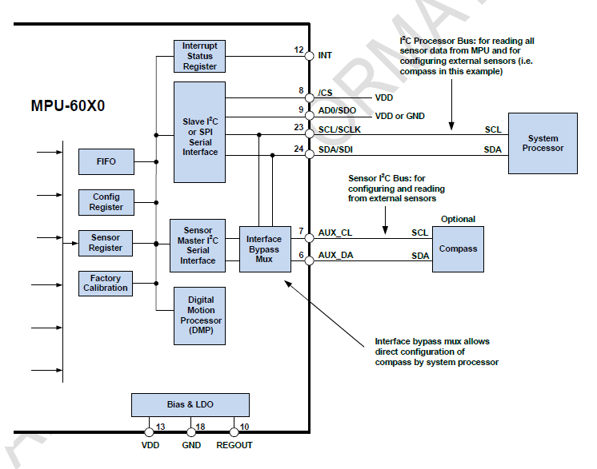
9-axis Sensor Fusion Using I2C Interface

